Slide 1



البرنامج التدريبي لتطوير مهارات حديثي التخرج لتعزيز فرص العمل
Data Science and Machine Learning
Module Six: Classification
Trainer: Dr Ayman Rawshdeh

Slide 2






Data Science and Machine Learning with R
Module 6 - Classification

Slide 3


Learning Objectives
Discuss classification and the types of classification algorithms
Describe logistic regression
Explain support vector machines
Discuss K-Nearest Neighbors (KNN) Explain Naive Bayes classifier
Describe decision tree and random forest classification Examine how to evaluate the classifier models

Slide 4
Classification
Topic 1—Classification and Its Types

Slide 5

Bank Loans
A bank has to analyze if loans should be granted to all their customers. There are a lot of variables like age, employment status, income, etc. to be considered.
How will the bank arrive at a process?

Slide 6

Bank Loans
With the help of decision tree classification algorithm, the bank decides if a customer should be granted a loan or not.

Slide 7
What Is Classification?
It is a technique to determine the extent to which a data sample will or will not be a part of a category or type. Classification models predict categorical class labels.

Slide 8
Classification Process
The classification process includes the following techniques for prediction:
Model Construction
Model Usage
It is done to describe a set of predetermined classes.
Every sample belongs to a predefined class.
The model is represented as decision
trees, classification rules, or mathematical formulae.
It is done to classify unknown or future objects and to estimate the accuracy of a model.
The accuracy rate is the percentage of the test set samples correctly
classified by the model. In case of acceptable accuracy, the model is used for classifying data samples with unknown class labels.

Slide 9


Classification Process
Here’s an example of model construction:
Classification Algorithms
Model Construction
Training Data
Model Usage
Classifier (Model)
Name | Rank | Years | Tenured
Mike | Assistant Professor | 6 | No
Bill | Assistant Professor | 7 | Yes
Dave | Assistant Professor | 3 | No
Anne | Professor | 2 | Yes
If Rank = “Professor”
Or Years > 6
Then Tenured = “Yes”

Slide 10


Classification Process
Here’s an example of model usage:
Classifier
Model Construction
Testing Data
Model Usage
Unseen Data
Name | Rank | Years | Tenured
Joseph | Assistant Professor | 7 | Yes
Tom | Assistant Professor | 2 | No
Merlisa | Assistant Professor | 7 | No
George | Professor | 5 | Yes
( Jeff, Professor, 4)
Tenured?
Yes

Slide 11
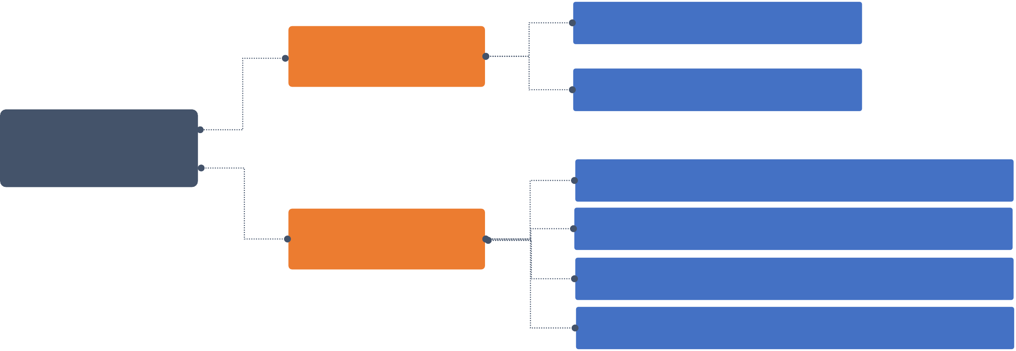
Types of Classification Algorithms
Logistic Regression
Linear Models
Support Vector Machines
Classification Algorithms
K-Nearest Neighbors (KNN)
Naive Bayes Classifier Decision Tree Classification
Random Forest Classification Random Forest Classification
Nonlinear Models

Slide 12
Classification
Topic 2—Logistic Regression

Slide 13
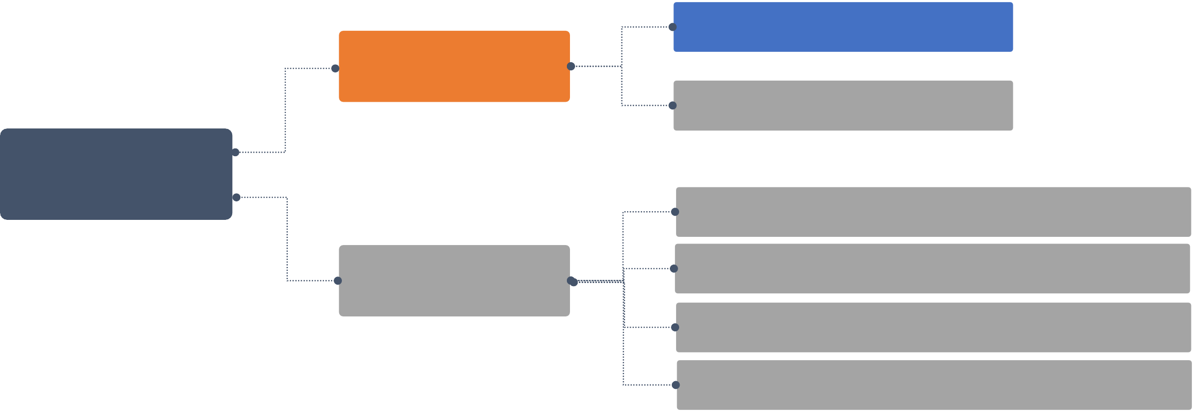
Types of Classification Algorithms
Logistic Regression
Linear Models
Support Vector Machines
Classification Algorithms
K-Nearest Neighbors (KNN)
Naive Bayes Classifier Decision Tree Classification
Random Forest Classification Random Forest Classification
Nonlinear Models

Slide 14
Logistic Regression
This method is widely used for binary classification problems. It can also be extended to multi-class classification problems.
Here, the dependent variable is categorical: y ϵ {0, 1}.
A binary dependent variable can have only two values, like 0 or 1, win or lose, pass or fail, healthy or sick, etc.
glm() in R is a class of regression models that supports non-normal distributions shown below
Family | Default Link Function
binomial | (link = "logit")
gaussian | (link = "identity")
Gamma | (link = "inverse")
inverse.gaussian | (link = "1/mu^2")
poisson | (link = "log")
quasi | (link = "identity", variance = "constant")
quasibinomial | (link = "logit")
quasipoisson | (link = "log")

Slide 15

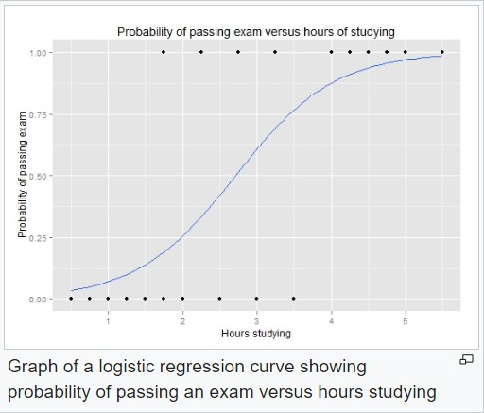
Logistic Regression
In this case, you model the probability distribution of output y
as 1 or 0. This is called as sigmoid probability (σ).
If σ(θTx) > 0.5, set y = 1, else set y = 0.
Unlike Linear Regression, there is no closed form solution for finding optimal weights of Logistic Regression. Instead, you must solve this with maximum likelihood estimation (a probability model to detect maximum likelihood of something happening).
It can be used to calculate the probability of a given outcome
in a binary model, like probability of being classified as sick or passing an exam.

Slide 16

Logistic Regression
The first equation shows the probability of output variable y being equal to 1 i.e. P(y = 1). It is equal to
sigmoid (σ) of θTx.
Note that θTx is the vector notation for θ1*x1 + θ2*x2 + θ3*x3 + …. + θn*xn.
The second equation shows the probability of output variable y being equal to 0 i.e. P(y) = 0.
The total of two probabilities is 1.

Slide 17

Logistic Regression
SIGMOID PROBABILITY
The probability in the logistic regression is often represented by the Sigmoid function (also called the logistic function or the S-curve):
In this equation, t represents data values * number of hours studied and S(t) represents the probability of passing the exam.
The points lying on the sigmoid function fits are either classified as positive or negative cases. A threshold is decided for classifying the cases.

Slide 18
Classification
Topic 3 — Support Vector Machines

Slide 19
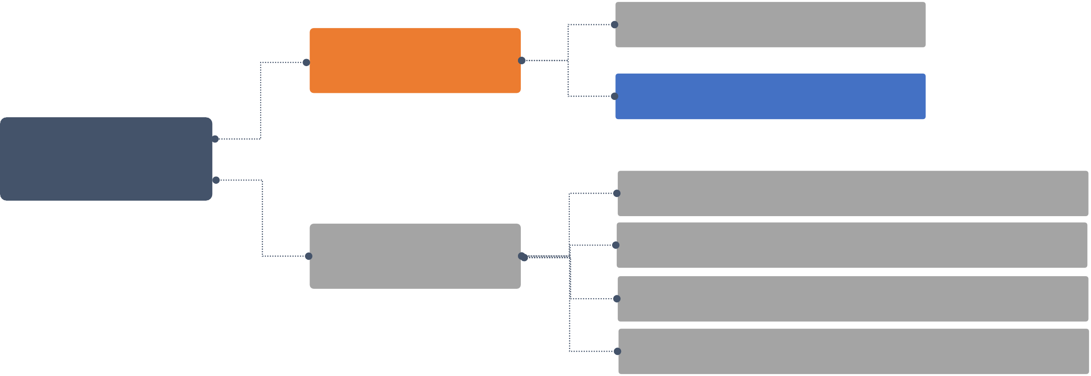
Types of Classification Algorithms
Logistic Regression
Linear Models
Support Vector Machines
Classification Algorithms
K-Nearest Neighbors (KNN)
Naive Bayes Classifier Decision Tree Classification
Random Forest Classification Random Forest Classification
Nonlinear Models

Slide 20
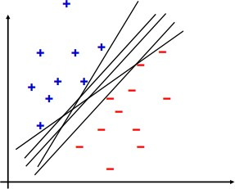
Support Vector Machines
Support Vector Machines (SVMs) are classification algorithms used to assign data to various classes.
They involve detecting hyperplanes (decision
boundary) which segregate data into classes.

Slide 21
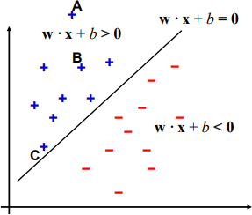
Support Vector Machines
CHOOSING HYPERPLANE
The hyperplane chosen should be such that all the points in the data set are far away from it. This helps in performing the classification easily.
For example, in the given graph it is easy to classify points A and B as they are reasonably far away from the hyperplane.
But one cannot classify C confidently as the point is very close to the hyperplane.

Slide 22
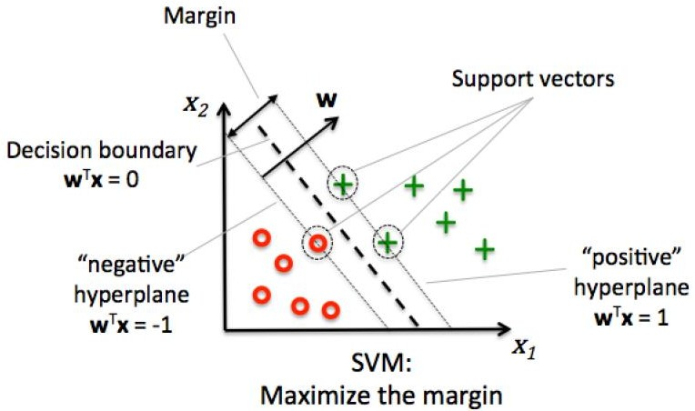
Support Vector Machines
MARGIN
Once ideal hyperplanes are discovered, new data points can be easily classified.
The objective of optimization is to maximize the distance between the data points (support vectors) and the hyperplane. This distance is called the margin.
Source: “Python Machine Learning” by Sebastian Raschka

Slide 23

Functional Margin
Functional margin of a point (x_{i},y_{i}) is:
Where w is a weight vector and b is bias
Functional margin indicates whether a particular point is properly classified or not. The result would be positive for properly classified points and negative otherwise.
Assume that the entire data is, at least, at distance 1 from the hyperplane. Then for a training set
{(x_{i} ,y_{i})}:
w^{T}x_{i} + b ≥ 1 if y_{i} = 1
w^{T}x_{i} + b ≤ −1 if y_{i} = −1

Slide 24
Geometric Margin
A geometric margin is the Euclidean distance between a certain data point x to the hyperplane. Geometric margin not only indicates if the point is properly classified or not, but also calculates the magnitude of the distance in term of units of |w|.

Slide 25
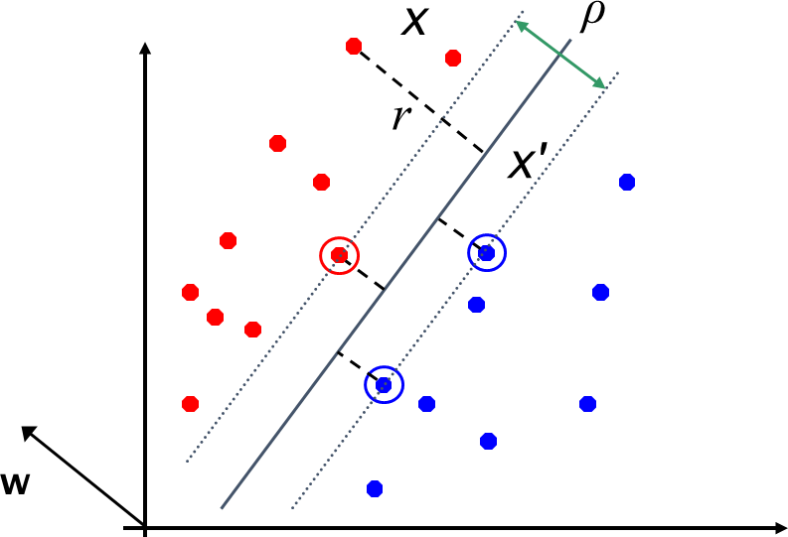
Calculation of Margin
Distance from a point to the separator is denoted by r.
A unit vector in this direction is w/|w|. Therefore, the dotted line in the diagram is rw/|w|.
Assuming the point closest to the hyperplane as x’,
x’ = x – yrw/|w| (1)
and
Using (2) in (1), Therefore:
x’ satisfies w^{T}x’+b = 0 ------------------------ (2)
w^{T}(x –yrw/|w|) + b = 0
r = y(w^{T}x + b)/|w|

Slide 26
Calculation of Margin
For the ease of solving large data sets, choose the functional margin of all data points as at least 1. So for all the data points,
y_{i}(w^{T}x_{i} + b) ≥ 1
Since each data point’s distance from the hyperplane is r = y(w^{T}x + b)/|w|, the geometric margin is ρ = 2/|w|
where ρ is the margin.

Slide 27
Implementation in R
e1071 is a package for R programming that provides functions for algorithms like: fuzzy classifier, naive Bayes classifier, bagged clustering, short-time Fourier transform, support vector machine
Applying “svm” function to a real data

Slide 28
Classification
Topic 4— K-Nearest Neighbours (KNN)

Slide 29
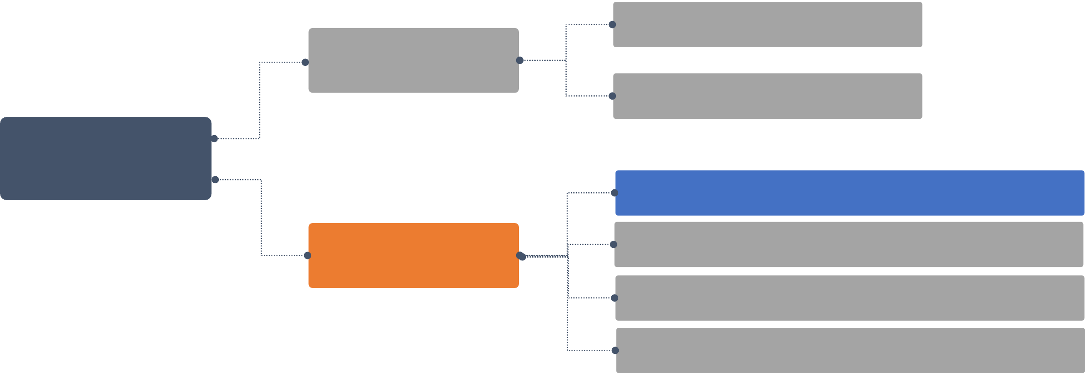
Types of Classification Algorithms
Logistic Regression
Linear Models
Support Vector Machines
Classification Algorithms
K-Nearest Neighbors (KNN)
Naive Bayes Classifier Decision Tree Classification
Random Forest Classification Random Forest Classification
Nonlinear Models

Slide 30
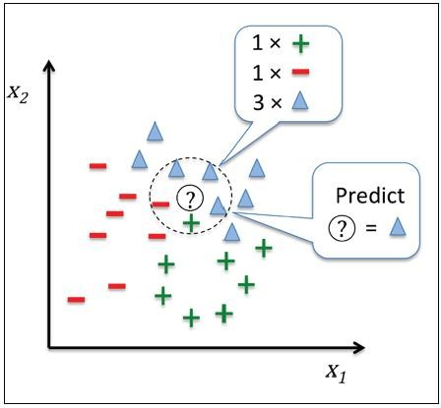
K-Nearest Neighbors (KNN)
K-nearest neighbors is an algorithm that classifies data points by a majority vote of its k neighbors.
It is used to assign a data point to clusters based on similarity
measurement.
A new input point is classified in the category such that it has the most number of neighbors from that category.
For example: Marking an email as spam or ham.

Slide 31
K-Nearest Neighbors (KNN)
STEPS TO CALCULATE THE ALGORITHM
Calculate the distance of the unknown data points with other training data points i.e. choose the number of k and a distance metric.
Identify k-nearest neighbors.
Use category of nearest neighbors to find the category of the new data points based on majority vote.

Slide 32
Choosing the Value of k
When choosing the value of k, keep the following points in mind:
If its value is too small, neighborhood is sensitive to noise points
If its value is too large, neighborhood may include points from other classes
X

Slide 33
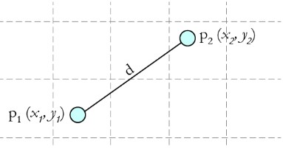

Computing Distance and Determining Class
For the Nearest Neighbor Classifiers, the distance between two points is expressed in the form of Euclidean distance, which is calculated by:
You can determine the class from the nearest neighbor list
by:
Taking the majority number of votes of class labels among the k-nearest neighbors
Weighing the vote according to the distance Weight factor, w = 1/d²

Slide 34
Implementation in R
class is a package for R programming that provides Various functions for classification: including k-nearest
neighbour, Learning Vector Quantization and Self-Organizing Maps
Applying “knn” function to a real data

Slide 35
Classification
Topic 5— Naive Bayes Classifier

Slide 36
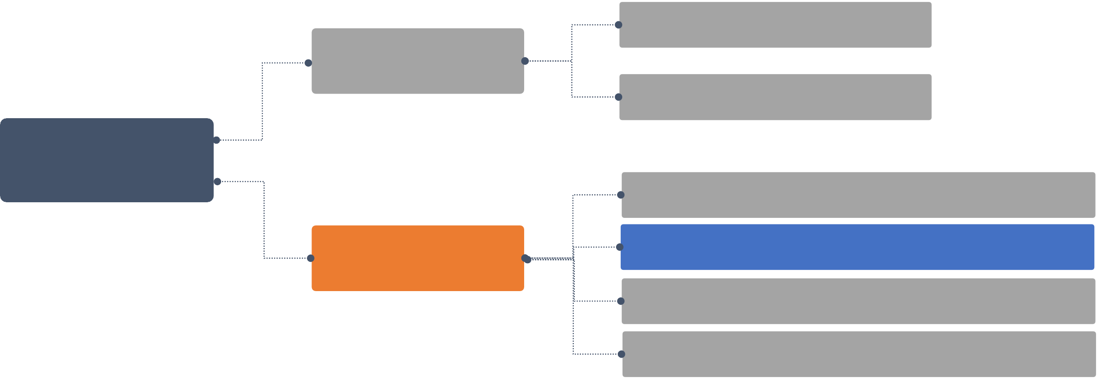
Types of Classification Algorithms
Logistic Regression
Linear Models
Support Vector Machines
Classification Algorithms
K-Nearest Neighbors (KNN)
Naive Bayes Classifier Decision Tree Classification
Random Forest Classification Random Forest Classification
Nonlinear Models

Slide 37
Naive Bayes Classifier
This is a probabilistic model which assumes conditional independence between features.
Given a set of features, Naive Bayes classifier is used to predict a class using probability.

Slide 38
Features of Naive Bayes Classifier
Probabilistic Learning
Determines explicit probabilities for hypothesis
Incremental
Allows each training example to incrementally increase or decrease the probability that a hypothesis is correct
Standard
Provides a standard of optimal decision making to measure other methods
Probabilistic Prediction
Predicts various hypotheses that are weighted by their probabilities

Slide 39
Bayesian Theorem
Assume:
X = Data sample with unknown class label H = A hypothesis that X belongs to class C
For classification, you need to determine:
P(H|X): Probability that the hypothesis holds, given the observed data sample X
P(H): Prior probability of hypothesis H
P(X): Probability that the sample data is observed
P(X|H): Probability of observing the sample X, given that the hypothesis holds

Slide 40
Bayesian Theorem
According to Bayes model, the conditional probability P(Y|X) can be calculated as:
P(Y|X) = P(X|Y)P(Y) / P(X)
This means you have to estimate a very large number of P(X|Y) probabilities for a relatively small vector
space X.
For example, for a Boolean Y and 30 possible Boolean attributes in the X vector, you will have to estimate 3 billion probabilities P(X|Y).
To make it practical, a Naive Bayes classifier is used, which assumes conditional independence of P(X) to
each other, with a given value of Y.
This reduces the number of probability estimates to 2*30=60 in the above example.

Slide 41
Implementation in R
naivebayes is a package for R programming that provides an efficient implementation of the popular Naïve Bayes classifier
Applying “naive_bayes” function to a real data

Slide 42
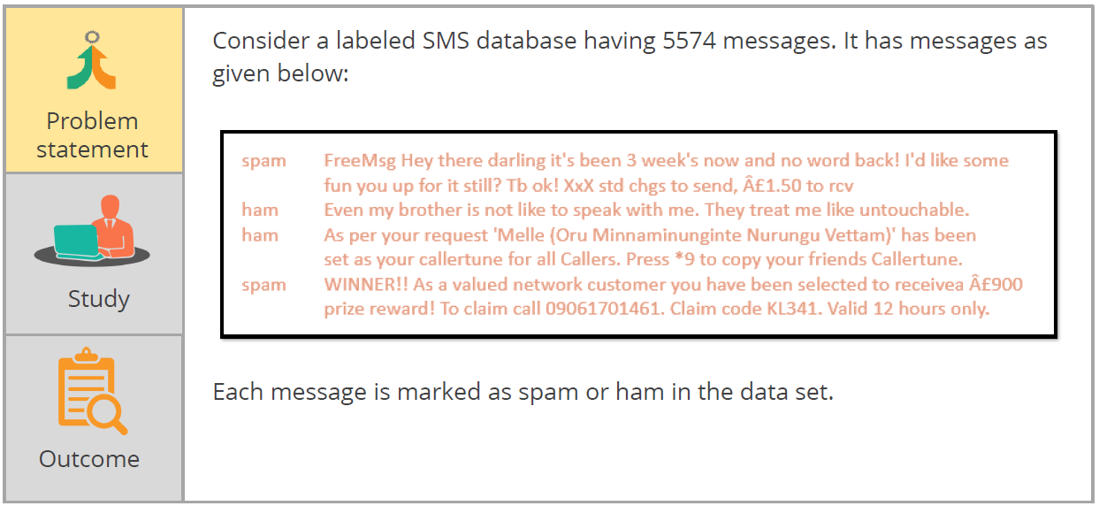
Detecting Spam

Slide 43
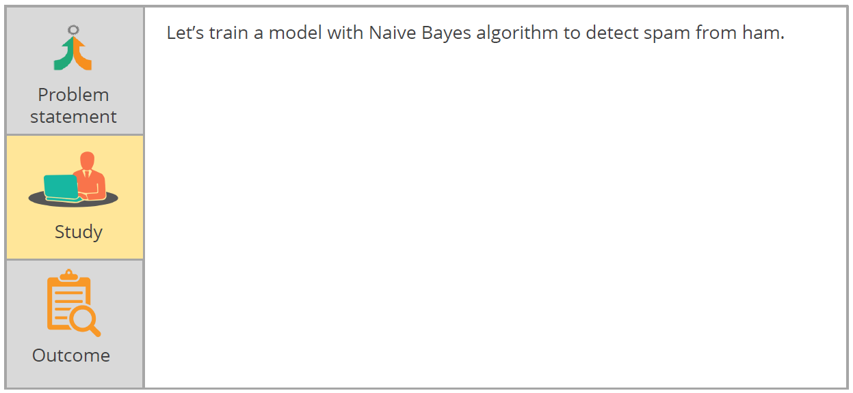
Detecting Spam

Slide 44
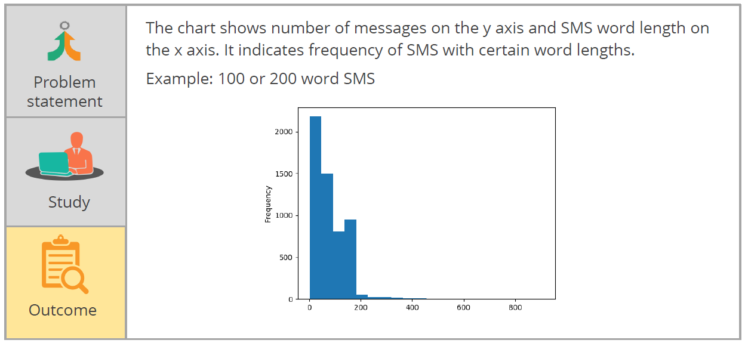
Detecting Spam

Slide 45
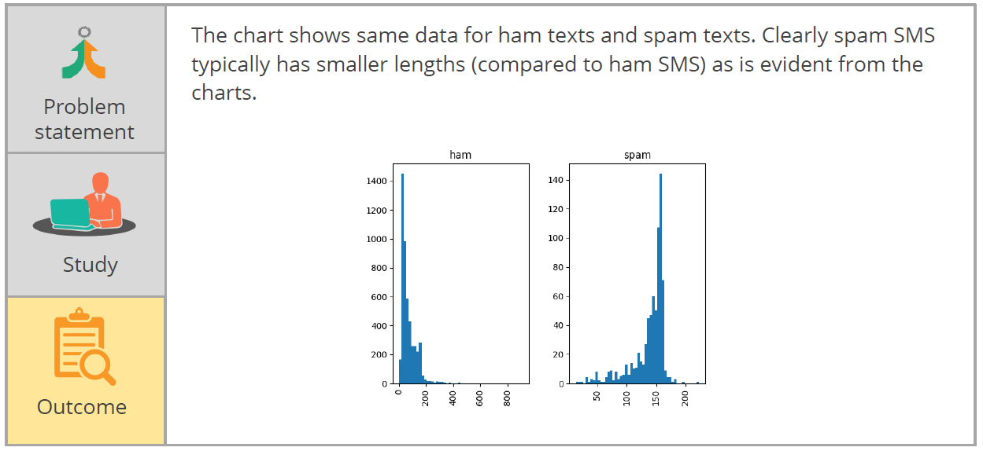
Detecting Spam

Slide 46
Classification
Topic 6 — Decision Tree Classification

Slide 47
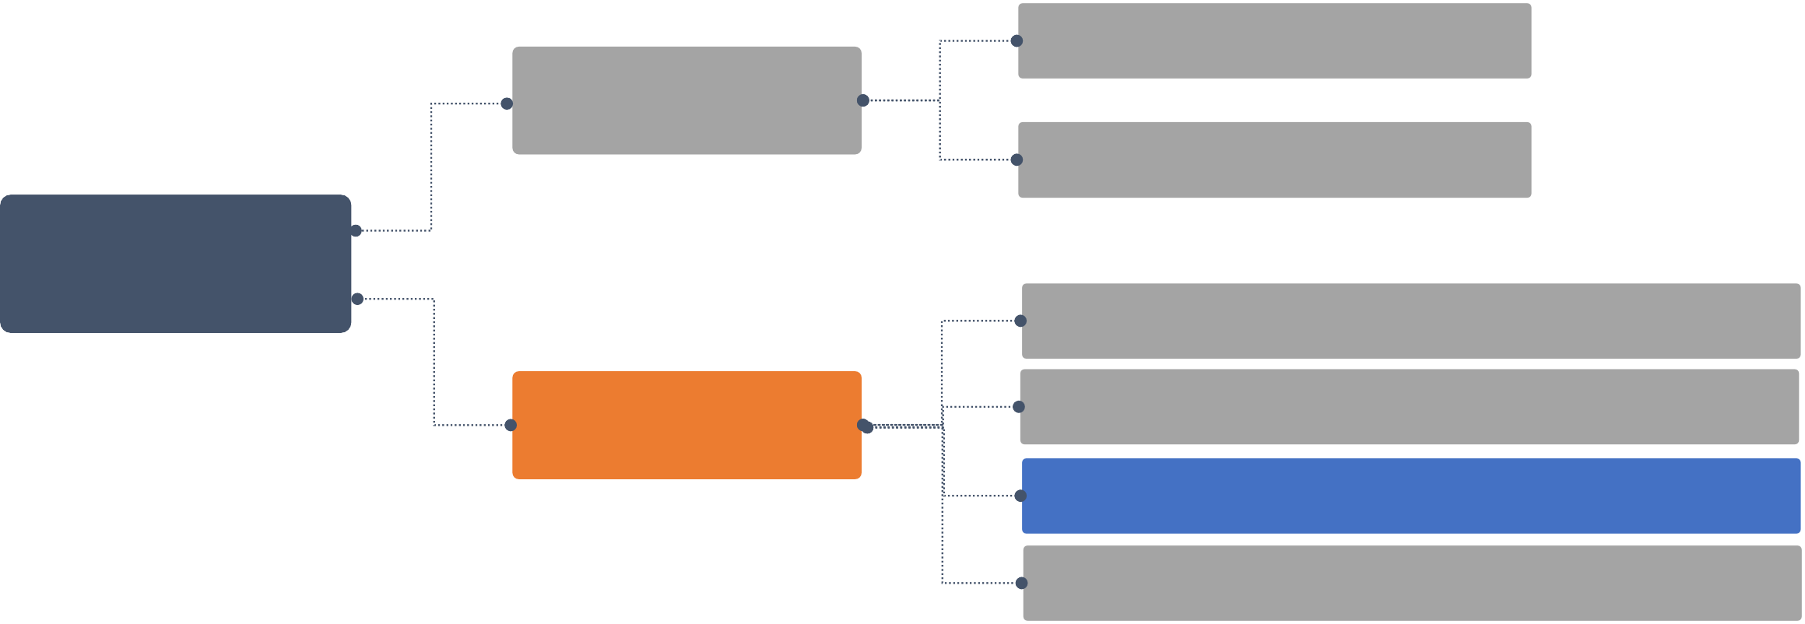
Types of Classification Algorithms
Logistic Regression
Linear Models
Support Vector Machines
Classification Algorithms
K-nearest Neighbors (KNN)
Naive Bayes Classifier Decision Tree Classification
Random Forest Classification
Nonlinear models

Slide 48
Decision Tree Classification
A decision tree is a graph that makes use of branching method to demonstrate every possible outcome of a decision.
In classification, the data is segregated based on a series of questions.

Slide 49
Advantages of Decision Tree
Has a faster learning speed than other classification methods
Can be converted to easy and simple classification rules
Can use SQL queries
Has a high classification accuracy

Slide 50

Basic Algorithm for a Decision Tree
A tree is constructed in a top-down manner and includes the following steps:
Place all training examples at the root
Categorize the attributes
Partition examples recursively based on the selected attributes
Select test attributes on the basis of a heuristic or statistical measure
Conditions to stop partitioning:
For a node, all samples belong to the same class.
No attributes are left for further partitioning.
No samples are left for classification.

Slide 51
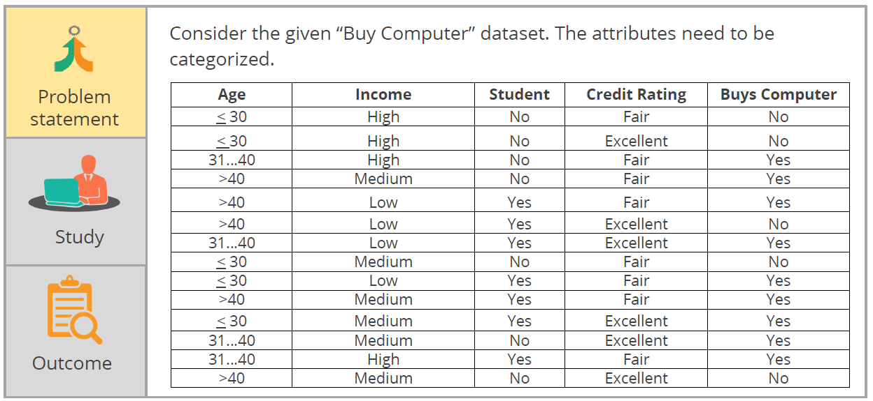
Decision to Buy Computer

Slide 52
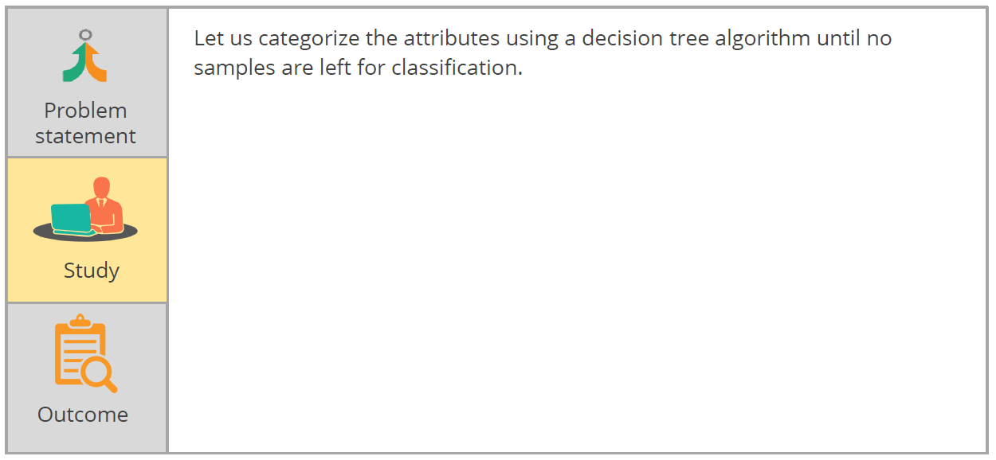
Decision to Buy Computer

Slide 53
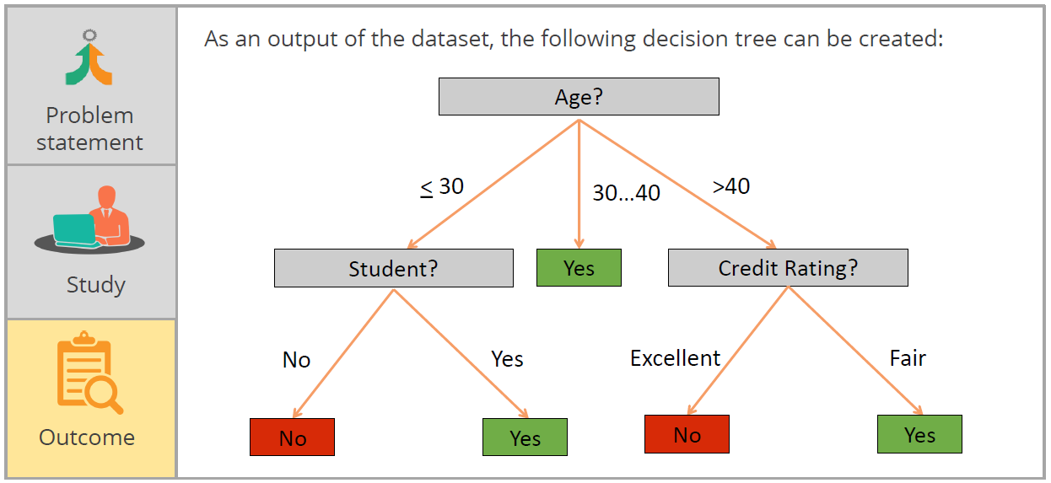
Decision to Buy Computer

Slide 54
Classification Rules of Trees
In these rules:
The statements are represented as IF-THEN rules
There is, at least, one rule for every path from the root to a leaf in a tree
A conjunction is formed for every attribute-value pair along a path in a tree
The class prediction is held by the leaf node in a tree
Let’s apply these rules on the “Buy Computer” dataset:
IF Age = “<=30” AND Student = “No” THEN buys_computer = “No” IF Age = “<=30” AND Student = “Yes” THEN buys_computer = “Yes” IF Age = “31…40” THEN buys_computer = “Yes”
IF Age = “>40” AND Credit Rating = “Excellent” THEN buys_computer = “Yes” IF Age = “<=30” AND Credit Rating = “Fair” THEN buys_computer = “No”

Slide 55
Overfitting in Classification
Sometimes, a tree may overfit the training data which can lead to issues, such as:
Too many branches
Less accurate and unseen samples
How to avoid overfitting?
There are two approaches:
Prepruning: Stop the construction of a tree early. If the goodness measure is falling below a threshold, do not split the node.
Postpruning: In case selecting an appropriate threshold is difficult, remove branches from a fully-developed tree by getting a progressively pruned trees’ sequence.

Slide 56
Tips to Find the Final Tree Size
Tip 1
Separate training (2/3) and testing (1/3) sets
Tip 2
Apply cross-validation
Tip 3
Use a statistical test (for example, chi-square) to determine whether pruning or expanding
a node can improve the distribution

Slide 57

Information Gain
Entropy is a measure of impurity, and information gain is the reduction that occurs in entropy as one traverses down the tree.
You need to select an attribute with the highest information gain, which is defined as:
Gain(A) = I(s ,s ,...,s ) − E(A)
1 2 m
Where,
S contains si samples of class Ci for i = {1, …, m}
Entropy of attribute A with values {a₁,a₂,…,a_{v}} :
v
s + ... + s
E(A) =
∑
j=1
1 j mj
s
I (s ,..., s )
1 j mj

Slide 58
Information Gain
EXAMPLE
Now, let’s consider the “Buy Computer” dataset, and calculate Gain(A).
Age | Income | Student | Credit Rating | Buys Computer
< 30 | High | No | Fair | No
< 30 | High | No | Excellent | No
31…40 | High | No | Fair | Yes
>40 | Medium | No | Fair | Yes
>40 | Low | Yes | Fair | Yes
>40 | Low | Yes | Excellent | No
31…40 | Low | Yes | Excellent | Yes
< 30 | Medium | No | Fair | No
< 30 | Low | Yes | Fair | Yes
>40 | Medium | Yes | Fair | Yes
< 30 | Medium | Yes | Excellent | Yes
31…40 | Medium | No | Excellent | Yes
31…40 | High | Yes | Fair | Yes
>40 | Medium | No | Excellent | No
Assume:
Class P: Buy Computer = “Yes” Class N: Buy Computer = “No”

Slide 59

Information Gain
EXAMPLE
The attributes of the “Buy Computer” table can be categorized as:
Age | p_{i} | n_{i} | I(p_{i}, n_{i})
< 30 | 2 | 3 | 0.971
>40 | 3 | 2 | 0.971
31…40 | 4 | 0 | 0
From the dataset, for age<30, class p_{i}=2, class n_{i}=3.
= 0.971
Similarly,
I(p, n) = I(9, 5) = 0.940

Slide 60
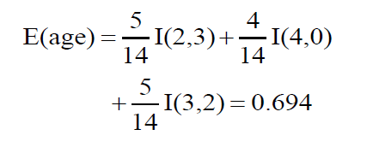
Information Gain
EXAMPLE
The entropy to identify the age will be calculated as follows:
Therefore, Gain(Age) will be calculated as follows:
Gain(age) = I(p,n) − E(age) = 0.246
Similarly for the other attributes,
Gain(income) = 0.029
Gain(student) = 0.151
Gain(credit_rating) = 0.048

Slide 61
Information Gain for Continuous-Value Attributes
A continuous-value attribute is one which takes numeric values.
Assume that A is a continuous-valued attribute. To calculate its Information Gain, you must determine the best midpoint for A by:
Sorting the values of A in an increasing order.
Selecting the midpoint between each pair of adjacent values.
Calculating entropy of each value.

Slide 62
Information Gain for Continuous-Value Attributes
EXAMPLE
Using the “Buy Computer” dataset, let us sort the data in increasing order.
Age | Buy Computer
18 | Yes
18 | No
25 | Yes
28 | Yes
28 | No
34 | No
45 | No
For middle point in first 2 numbers:
Mid point = (18+25)/2 = 21

Slide 63
Information Gain for Continuous-Value Attributes
EXAMPLE
Information gain, Infoage<21(D):
= 2/7(l(1,1)) + 5/7(l(2,3))
= 2/7 (-1/2(log2(1/2)) – 1/2(log2(1/2)) + 5/7(-2/5(log2(2/5))-3/5(log2(3/5)))
=.98
Age | Buy Computer
18 | Yes
18 | No
25 | Yes
28 | Yes
28 | No
34 | No
45 | No

Slide 64
Implementation in R
Rpart is a powerful machine learning library that is used for building classification and regression trees
Applying “rpart” function to a real data

Slide 65
Classification
Topic 7 — Random Forest Classification

Slide 66
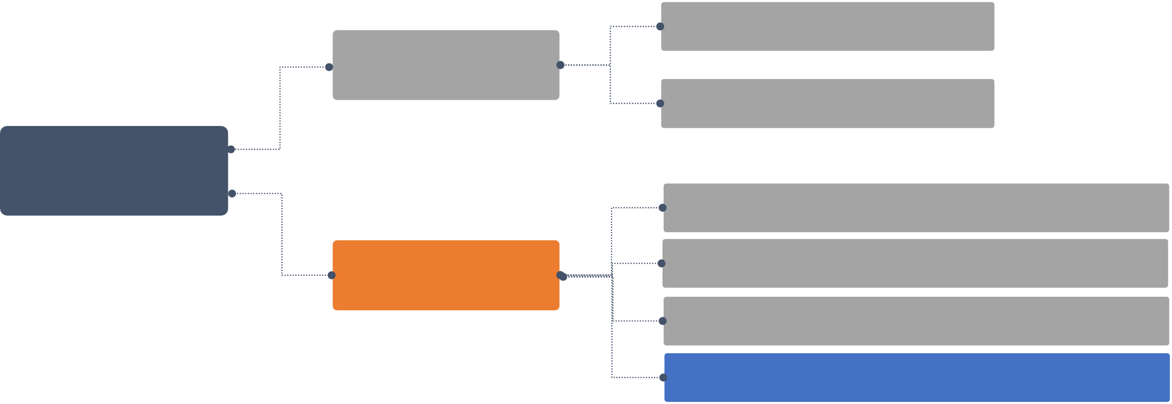
Types of Classification Algorithms
Logistic Regression
Linear Models
Support Vector Machines
Classification Algorithms
K-Nearest Neighbors (KNN)
Naive Bayes Classifier Decision Tree Classification
Random Forest Classification Random Forest Classification
Nonlinear Models

Slide 67
Random Forest Classification
A random forest can be considered an ensemble of decision trees. It builds and combines multiple decision trees to get a more accurate prediction.
Each of the decision tree models used is weak when employed on its own, but it becomes stable when put together.
They are called random because they operate by choosing predictors randomly at the time of training the model.
They are called forests because they take the output of multiple decision trees to make a decision.

Slide 68
Random Forest Algorithm
STEPS TO FOLLOW
Draw a random bootstrap sample of size n (randomly choose n samples from the training set).
Grow a decision tree from the bootstrap sample. At each node, randomly select d features.
Split the node using the feature that provides best split according to objective function, for instance by maximizing the information gain.
Repeat the steps 1 to 2 k times (k is the number of trees you want to create, using a subset of samples).
Aggregate the prediction by each tree for a new data point to assign the class label by majority vote
(pick the group selected by most number of trees and assign new data point to that group).

Slide 69
Implementation in R
randomForest is a powerful machine learning library that is an ensemble of decision treestrees
Applying “randomForest” function to a real data

Slide 70
Classification
Topic 8 — Evaluating Classifier Models

Slide 71
Evaluating Classifier Models
Evaluating a model is important to know the accuracy and performance of a model.
To evaluate a model, different metrics are used.
Confusion Matrix
Gain and Lift Chart
Kolmogorov Smirnov Chart
AUC – ROC curve
Gini Coefficient
Concordant – Discordant Ratio
Root Mean Squared Error
In this course the focus will be on confusion matrix and AUC-ROC curve.

Slide 72
Confusion Matrix
A confusion matrix examines all possible outcomes of prediction: true positive, true negative, false positive and false negative.

Slide 73
Confusion Matrix
FALSE POSITIVE AND FALSE NEGATIVE
False Positive
True
Positive
Y Predicted
False Positives are like false alarms. They are called Type I error. They occur when a negative occurrence is wrongly classified as positive.
^{Y}predicted⁼¹
^{Y}predicted⁼¹
1
0.5
False Negatives are also called Type II error. They occur when a positive occurrence is wrongly classified as negative.
^{Y}predicted⁼⁰
^{Y}predicted⁼⁰
X
True
Negative
False
Negative

Slide 74
Confusion Matrix
PARAMETERS
The parameters calculated from a confusion matrix are:
Accuracy rate: The proportion of the total number of predictions that were right
Precision/Positive Predicted Value: The proportion of positive cases that were correctly identified
Negative Predictive Value: The proportion of negative cases that were correctly identified
Recall/Sensitivity/True Positive Rate: The proportion of actual positive cases which are correctly identified
Specificity/ True Negative Rate: The proportion of actual negative cases which are correctly identified

Slide 75
Confusion Matrix
PARAMETERS
 |  | Predicted
 |  | 0 | 1
Actual | 0 | TN (True Negatives) | FP (False Positives)
 | 1 | FN (False Negatives) | TP (True Positives)
Accuracy Rate = (TP + TN) /(TP+TN+FP+FN)
Error Rate = (FP + FN) /(TP+TN+FP+FN)
Precision/ Positive Predicted Value = (TP) /(TP+FP)
Recall/Sensitivity/True Positive Rate = (TP) /(TP+FN)
Specificity/ True Negative Rate= (TN) /(TN+FP)

Slide 76
AUC – ROC Curve
The ROC (Receiver Operating Characteristic curve) is the plot between True Positive Rate (Sensitivity) and the False Positive Rate (1- Specificity) for a classifier.
AUC: AUC or the Area Under the Curve is a measure of classifier’s performance. A random classifier has an AUC of 0.5, whereas a perfect classifier has an AUC of 1.
Sensitivity
1- Specificity

Slide 77
Bias Variance Trade-off
Bias variance trade-off determines the model’s ability to keep bias and variance to the minimum.
Bias is a measure of error on how much the predicated values differ from the actual value.
Variance indicates an algorithm’s sensitivity to small changes in the training dataset.
The error in a predictive model can be summarized as a summation of bias, variance, and irreducible error.
Irreducible error, also known as noise, cannot be reduced by any algorithm.

Slide 78
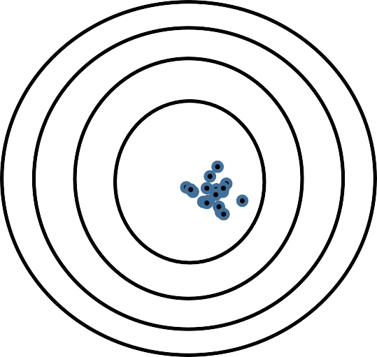
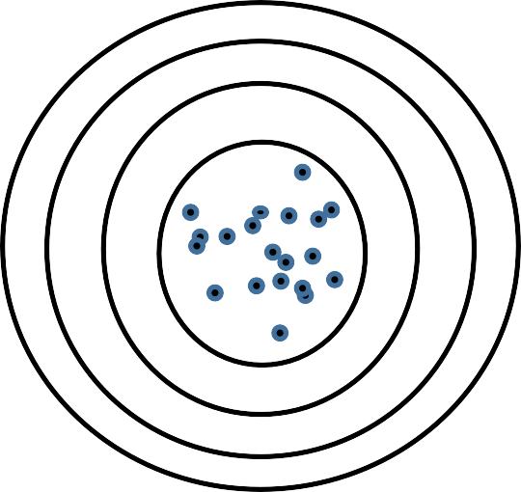
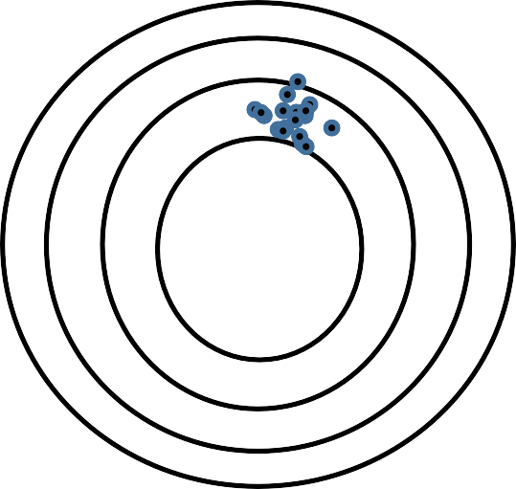
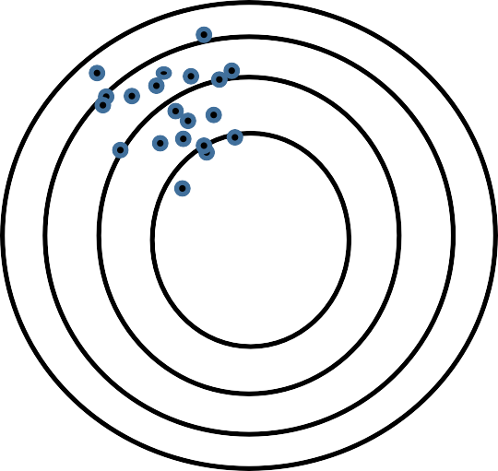
Bias Variance Trade-off
The goal of any classification algorithm is to achieve low bias and low variance.
Low Variance
High Variance
Low Bias
High Bias

Slide 79
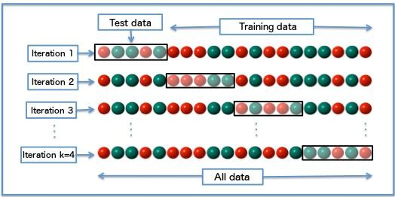
K-Fold Cross Validation
ALGORITHM
Original sample data is split into k random samples of equal sizes each.
One out of k number of samples is selected as Test data while other k-1 samples are combined together into Training data. The model is built on k-1 folds and tested on k^{th} fold.
Repeat the process for each of the k^{th} fold. The test data is rotated each time until all k number of samples
have been allotted to test data at least once.
The average error across folds is called the performance of the model.

Slide 80


Key Takeaways
Classification is a technique to determine the extent to which a data sample will
or will not be a part of a category or type.
The classification process uses two techniques for prediction: model construction and model usage.
Different classification techniques include logistic regression, support vector machines, K-nearest neighbors, Naive Bayes classifier, decision tree, and random forest classification.
Bias and Variance are the two types of major errors in a predictive model.
Validation methods such as K-fold cross validation can be used to decrease overfitting in a model.

Slide 81
This concludes “Classification.”

